Slide 1
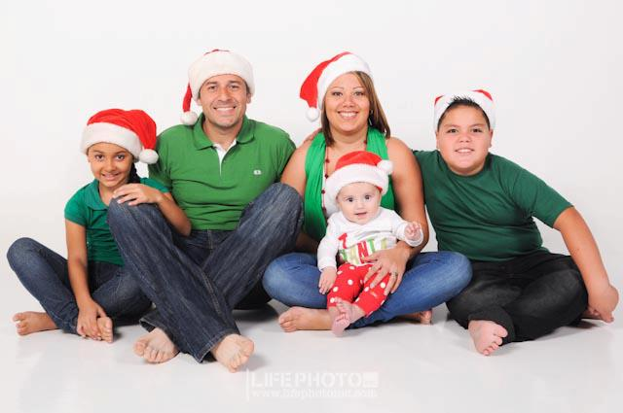
Project #4. Interview to Jafet Cordero Chacón
English II. Jahzeel Ricardo Cordero Cordero

Slide 2
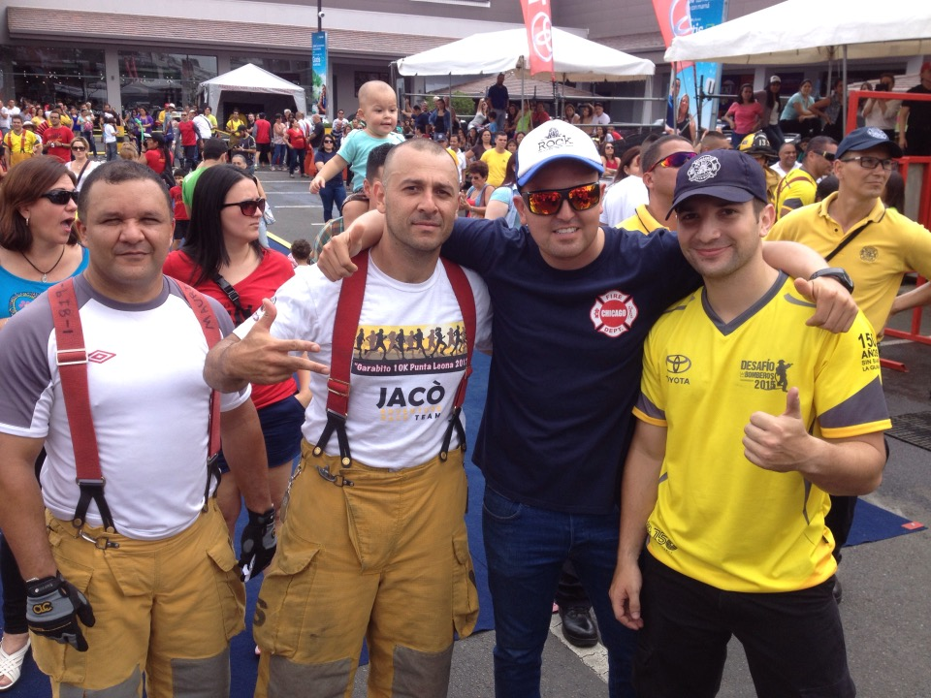
Who is Jafet Cordero Chacón?
He is the current head of paramedics, San Jose in Costa Rica.
He is a firefighter and paramedic by profession, with over 15 years of work in the Fire Department of Costa Rica.
He is son of Rafael Angel Cordero Saborío (ex-commander of Fire Department of Costa Rica) and Antonieta Chacón Monge.
He has more than 40 titles on rescuing people and animals; in addition to extensive studies in first aid.
He is married with Alejandra Vado and he is the father of three children (Ariela, Eduardo and Andres).

Slide 3

Tell me about yourself. How did it all?. What was your inspiration?
“I was born on July 26, 1979. My first studies were in the School Joaquín García Monge, also I studied at the Liceo de Costa Rica. I prepared at the National Fire Academy; I am a firefighter and paramedic by profession.
My inspiration started when I realized that saving people is a privilege and I definitely wanted to follow the steps of my dad.”

Slide 4
In your opinion, what is the meaning of "success"?
“I think that "success" means: Achieving the goals that each one sets, regardless of others' opinions.”

Slide 5
Why have you succeeded in a complicated field where so many others have failed?
“Being a firefighter is not easy, there are days when I do not sleep, I've spent Christmas in a fire, and some birthday I've been away from my family.
I have had success by my love for the people, and perseverance.”

Slide 6
If you could go back in time what would you do differently?
“I would definitely have been more studious at school.”

Slide 7
What has been your formula for success?
“I'm sure the delivery and passion for what is done.”

Slide 8
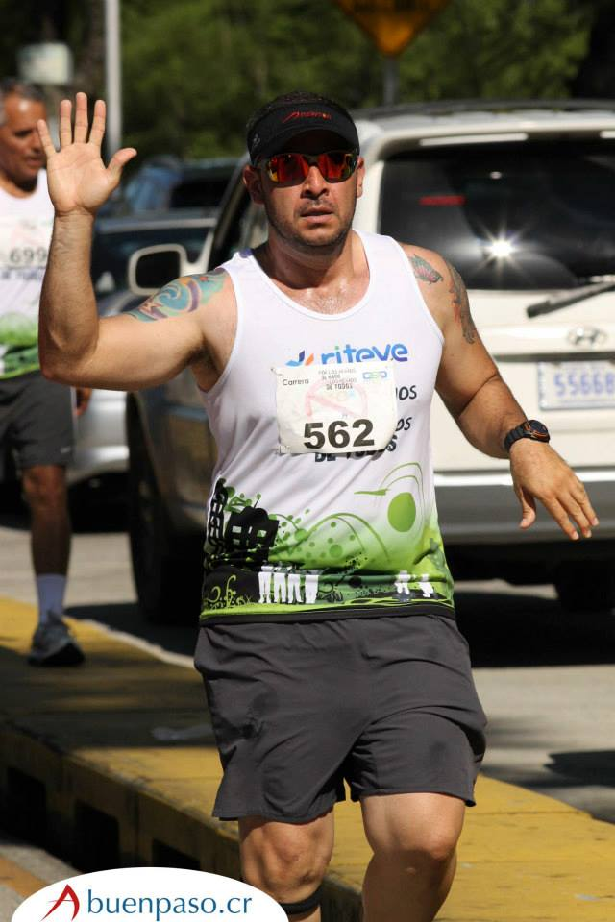
What has been your greatest achievement?
“My greatest achievement has been to be a father and I love my work”

Slide 9

Thank you!

