Slide 1


Slide 2

What is Ecotourism?

Slide 3
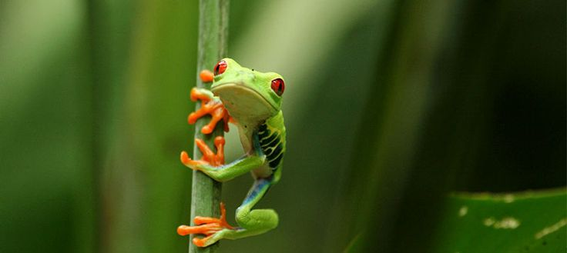

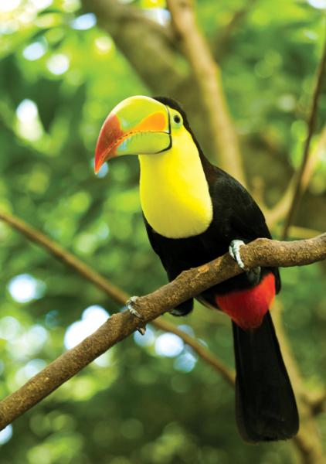
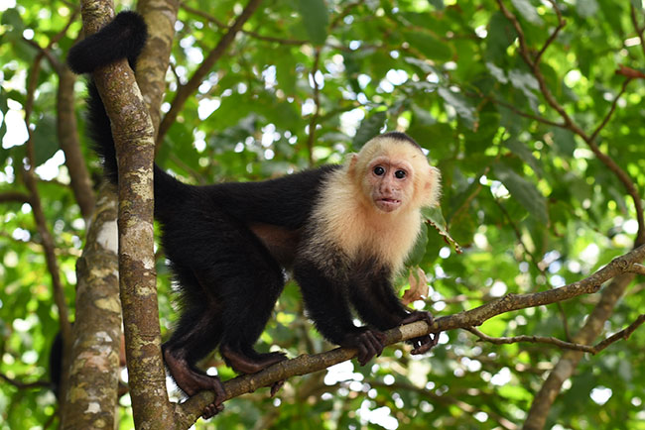
Ecotourism is the responsible travel to natural areas that conserves the environment, sustains the well-being of the local people, and involves interpretation and education.

Slide 4
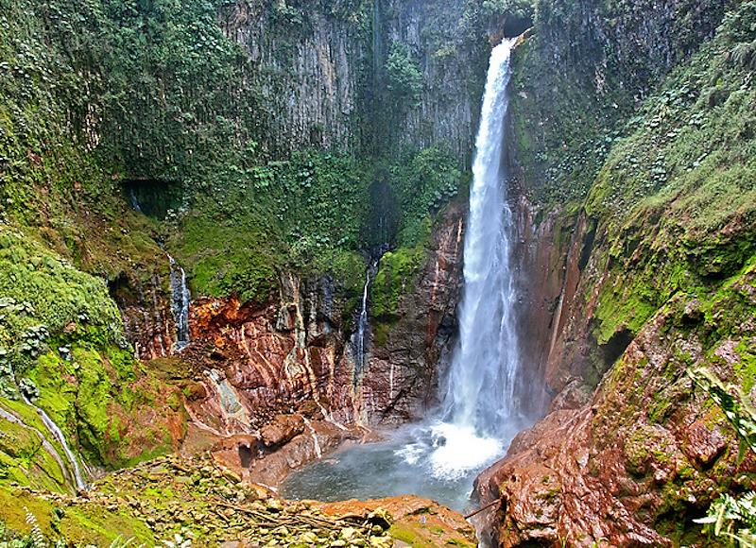
Disadvantages and advantages

Slide 5

Advantages
Preservation of Surrounding Environment: The idea of eco-tourism revolves around visiting beautiful places and protecting environment through it.
Scopes of Employment for Local People: The eco-tourism industry is seeing an impact as the concept is getting much popular with each passing day.
Deep and Diverse Cultural Impacts: Eco-tourism is not only about exploring exotic landscapes, taking care of natural resources and enhancing the economy of a certain region; it comes with intense socio-cultural effects.

Slide 6


Disadvantages
Degradation of Environment: Like all other unique environmental efforts, eco-tourism also has some negative impacts on our surroundings.
Disturbance Caused to the Wildlife: Each and every type of tourism interrupts the quiet and peaceful wildlife. In spite of lots of promotion of eco-tourism, people do not care much about the inconvenience caused to the birds and animals due to their illogical demands, wishes and behavior.

Slide 7


Slide 8
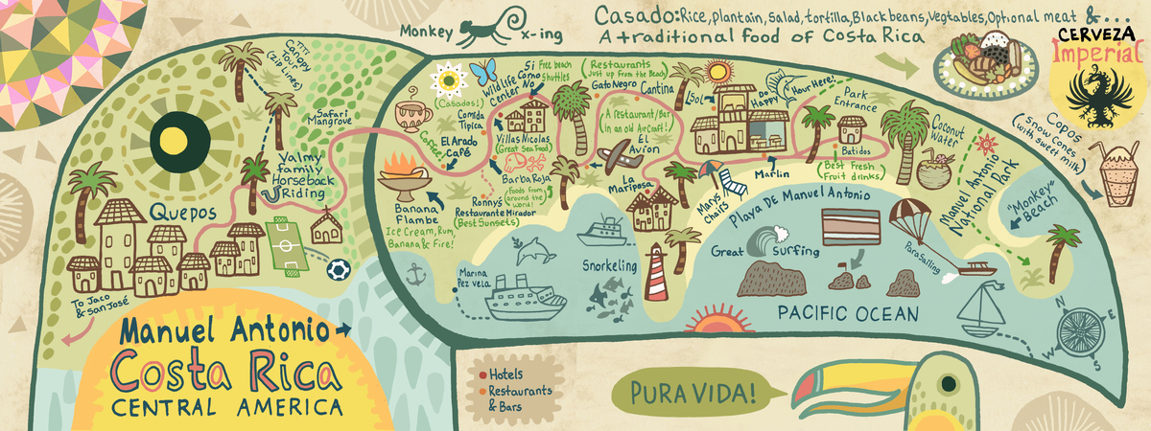
Costa Rica and Ecotourism
Manuel Antonio National Park

Slide 9
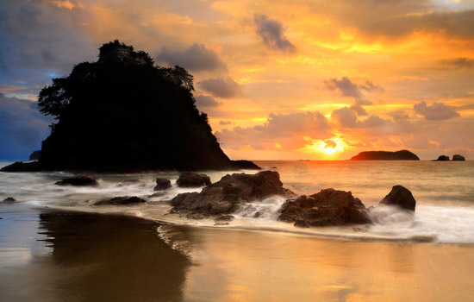
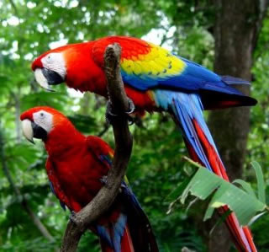
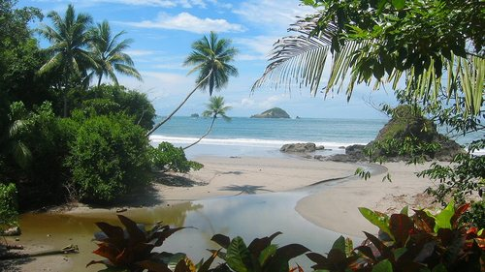
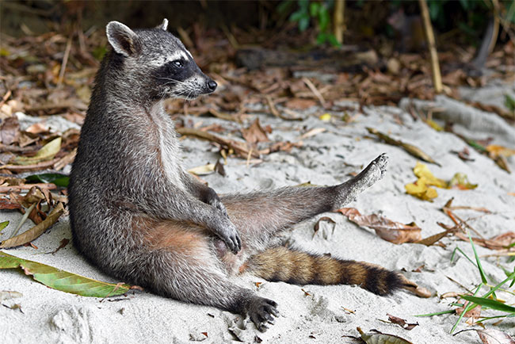
Located 120 miles (192 km) from San Jose on the Pacific coast, Manuel Antonio National Park is internationally recognized as being one of the most biodiverse parks on the planet. Lush tropical forests, lagoons, mangroves and pristine white sandy beaches make up one of the most diverse ecosystems imaginable.
Among the 109 species of mammals and 184 species of birds, some of the frequently viewed residents include white-faced and howler monkeys, two and three toed sloths and iguanas.

Slide 10
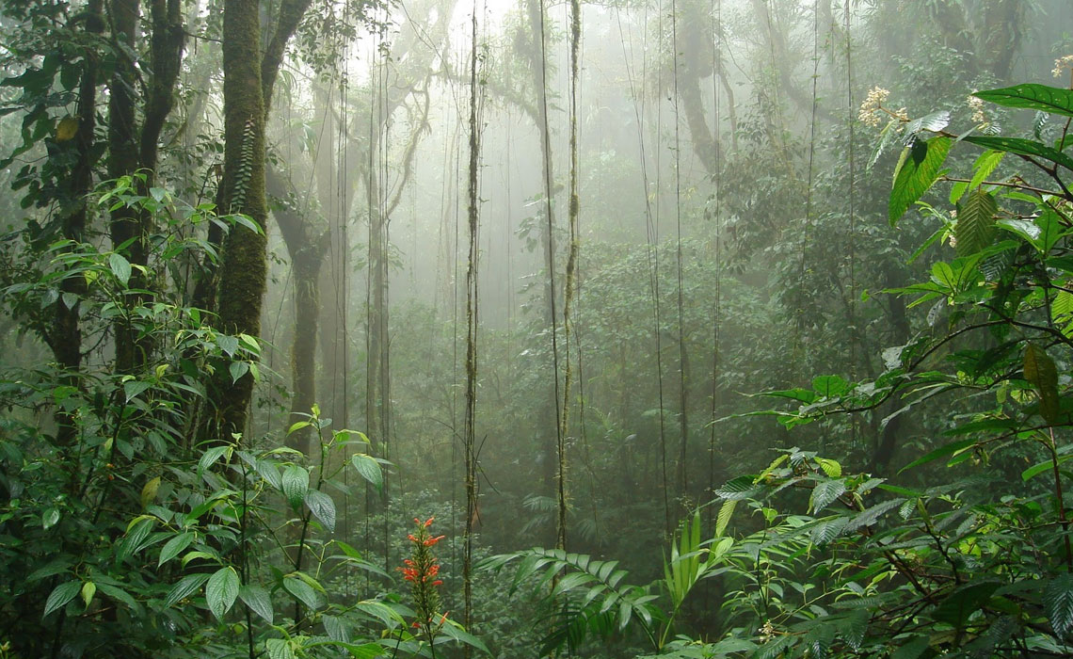
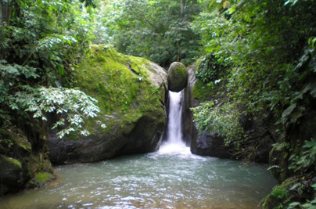
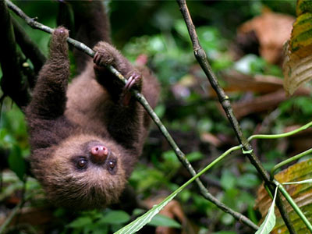
Monteverde Cloud Forest
Monteverde is a world above the coastal towns that dot the country's famous shoreline. It is a place of cloud forests and coffee plantations, monkeys, mist, and friendly locals. The town of Santa Elena is small and quaint, filled with tasty restaurants and folksy artisan shops, while the nearby rainforest hosts a remarkable amount of biodiversity.

Slide 11
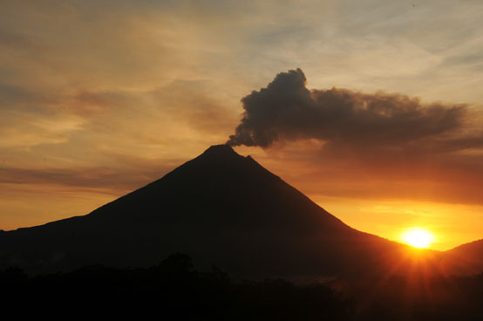
What are the principles
of ecotourism?

Slide 12



a) Build environmental and cultural awareness and respect
d) Design, construct and operate low-impact facilities.
c) Provide direct financial benefits for conservation

Slide 13
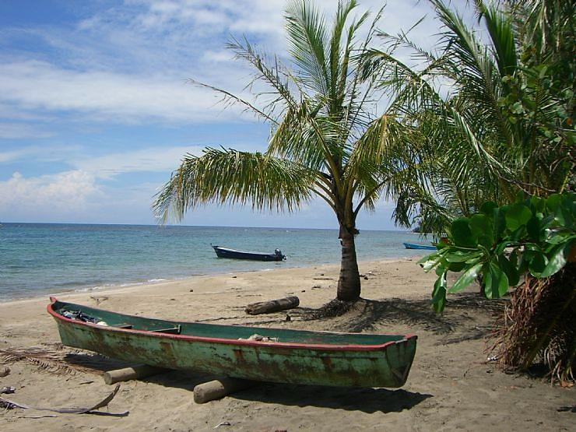
Brochure

Slide 14
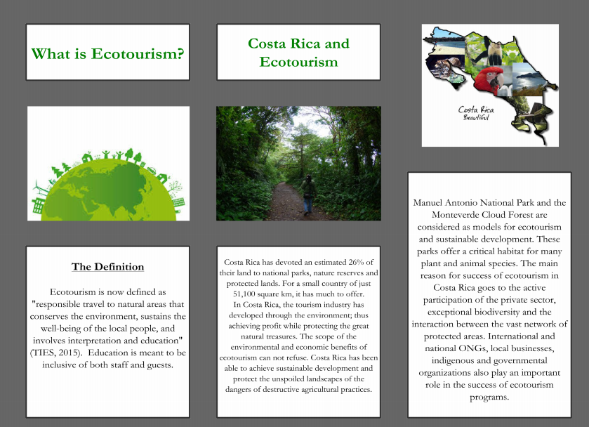

Slide 15


