Slide 1
REMBRANDT®

Slide 2
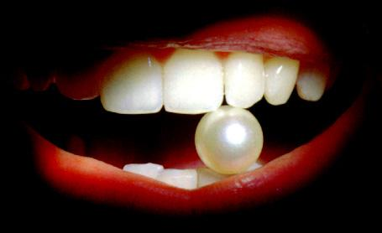
Would you like to have…?

Slide 3
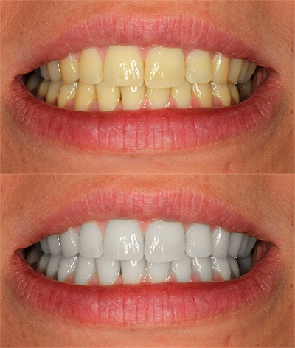
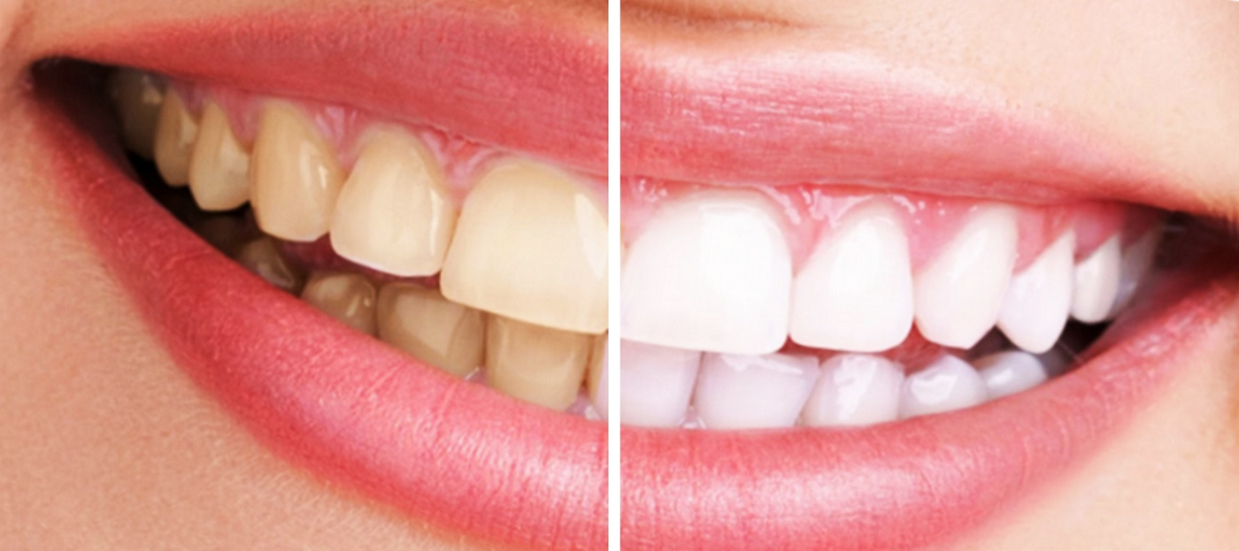
Before
After
White
teeth

Slide 4
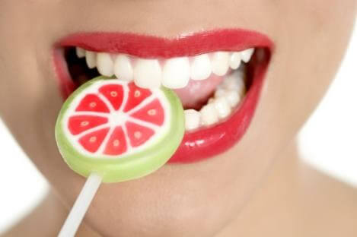
Perfect Smile

Slide 5
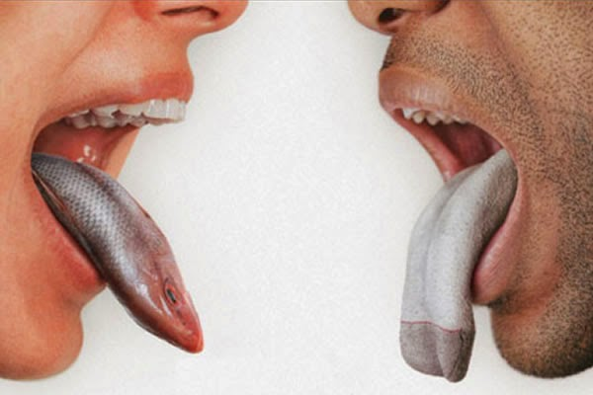
Fresh breath

Slide 6
What is the secret?

Slide 7
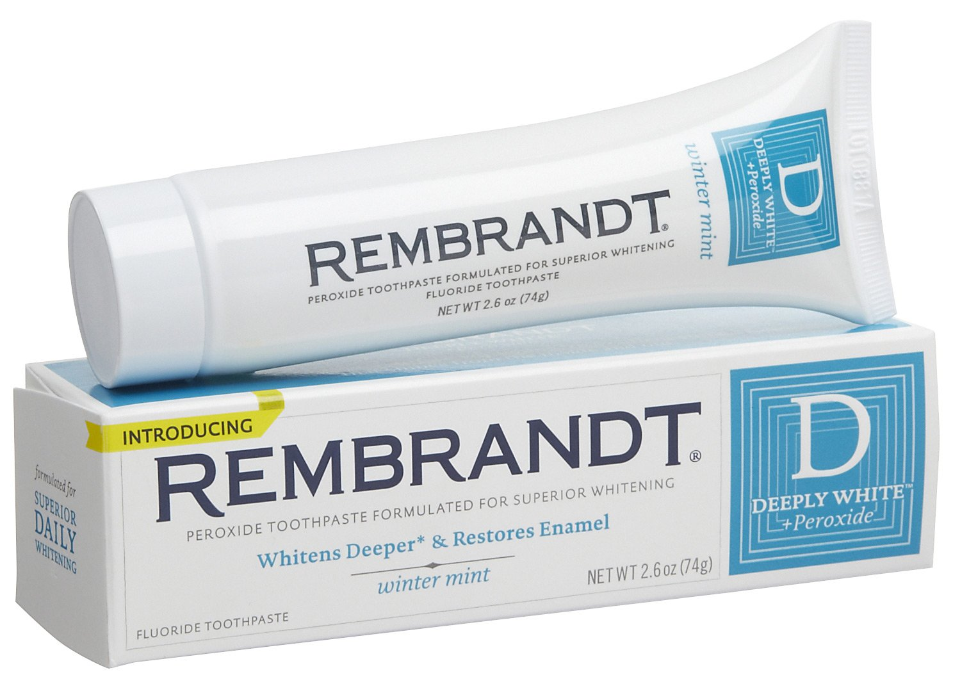
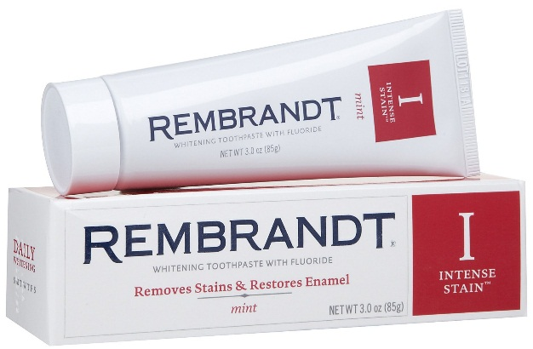
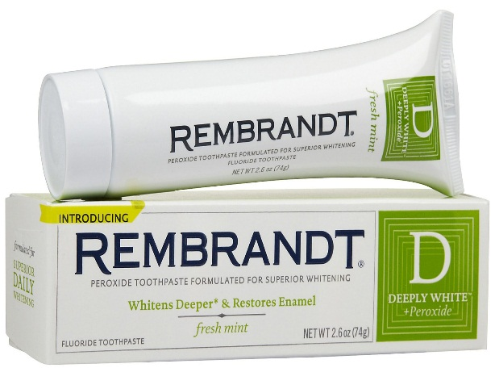
Quality

Slide 8
REMBRANDT®
Keep enjoying your favorite food and drinks (red wine, coffee and coke) while you polish away stains with REMBRANDT toothpaste, the
#1-selling premium whitening toothpaste.
This advanced daily-use toothpaste is expertly formulated to remove tough stains, prevent new stains from sticking and actively restore and strengthen tooth enamel.

Slide 9
Smile at life

Slide 10
Choose
REMBRANDT®
https://www.youtube.com/watch?v=GtKIS5Nbl2k

