Slide 1


Slide 2


Our objective with this survey was to measure the reasons why a person is cheating, and therefore make people surveyed placed his criteria of importance with regard to fidelity to carry out a good relationship. The results achieved were very significant, 30 people made the survey

Slide 3
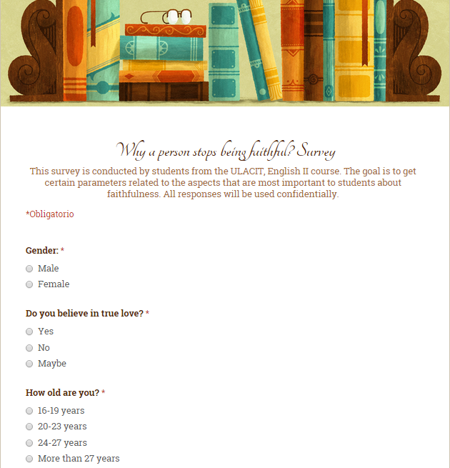
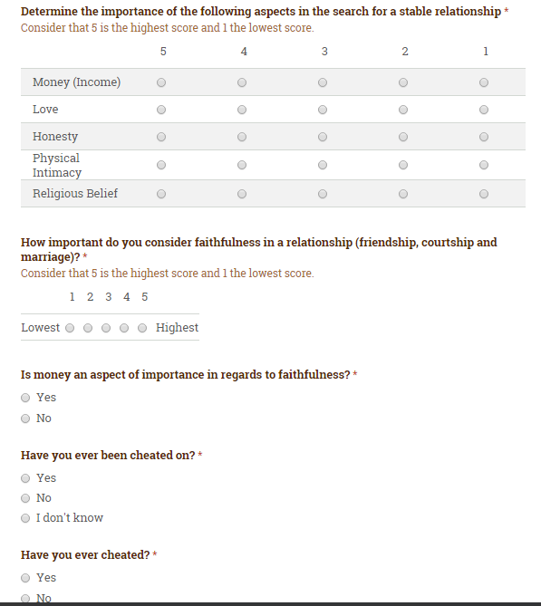

Slide 4


Slide 5
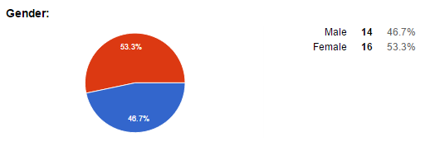

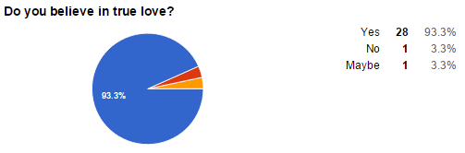

Slide 6
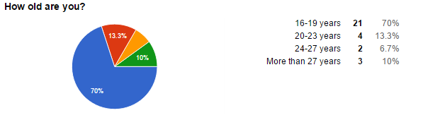
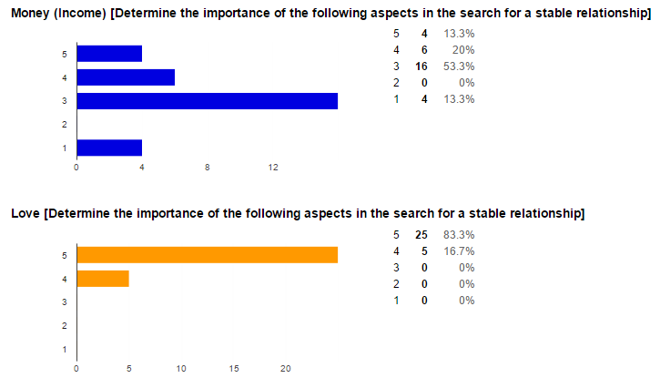
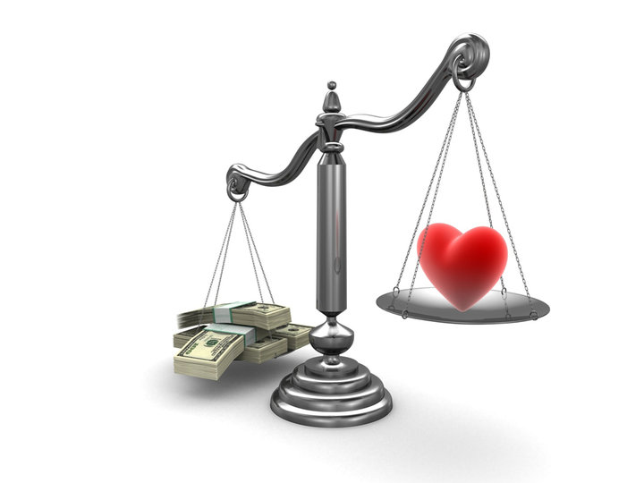
What is most needed for a stable relationship?

Slide 7
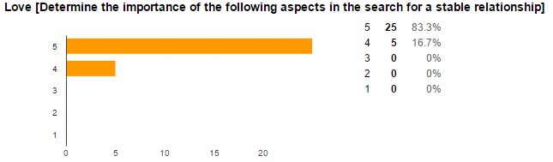


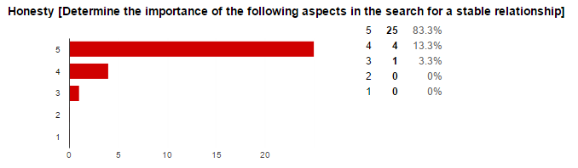



Slide 8
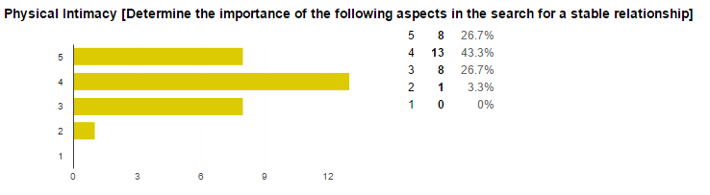
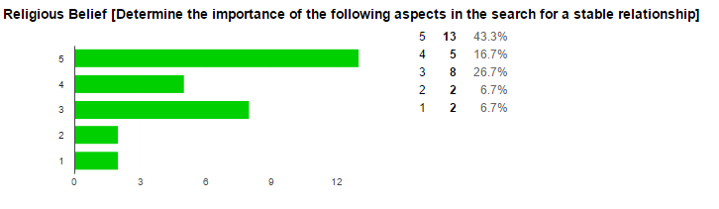


Slide 9
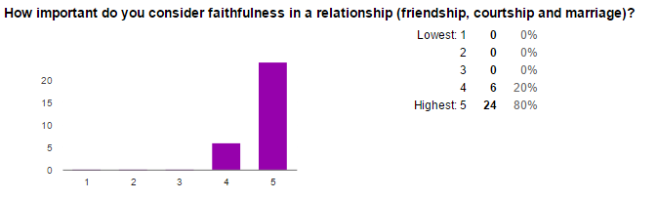
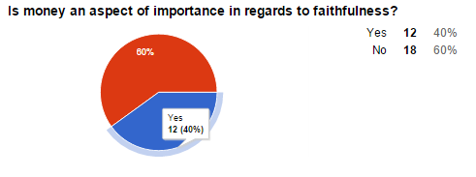


Slide 10
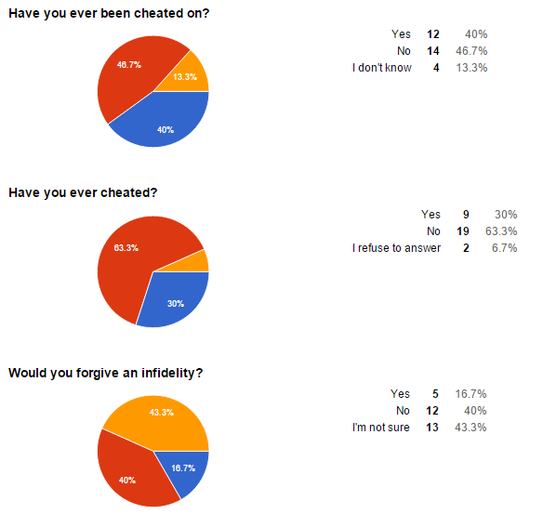

Slide 11
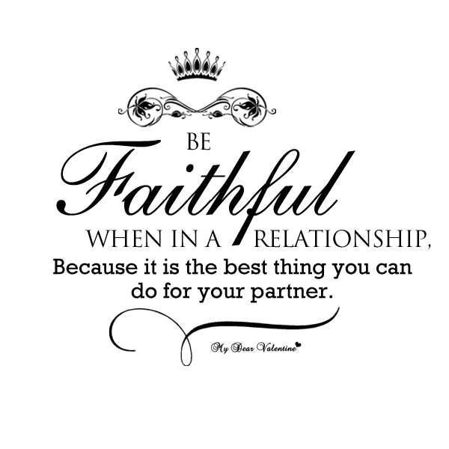

Those 30 people who responded to the survey believe that the most important thing in a relationship is love and faithful, they don't consider the money has a lot of weight in a relationship, but it is important to a life good, most people have not been unfaithful and they don't forgive an infidelity and all believe in true love
CONCLUSION

Slide 12


Slide 13


