Slide 5
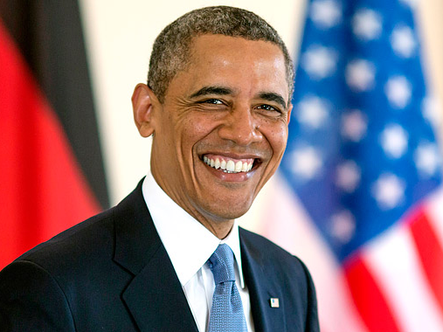
What was your inspiration?

Slide 6
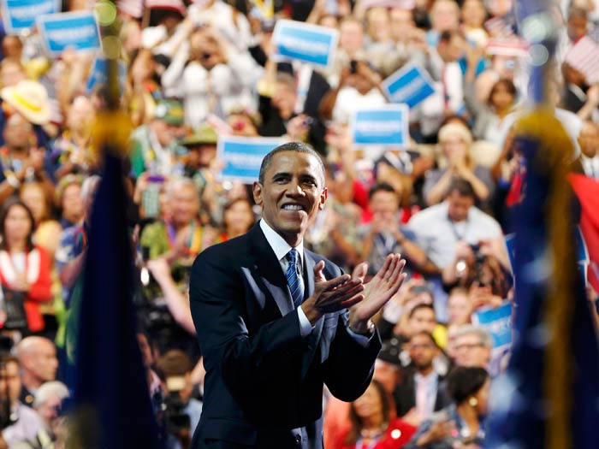
How did you become successful?

Slide 7
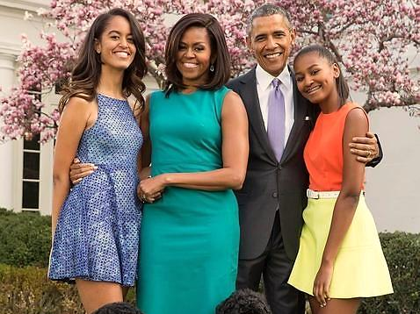
How influences your wife and daughters in your life?

Slide 8
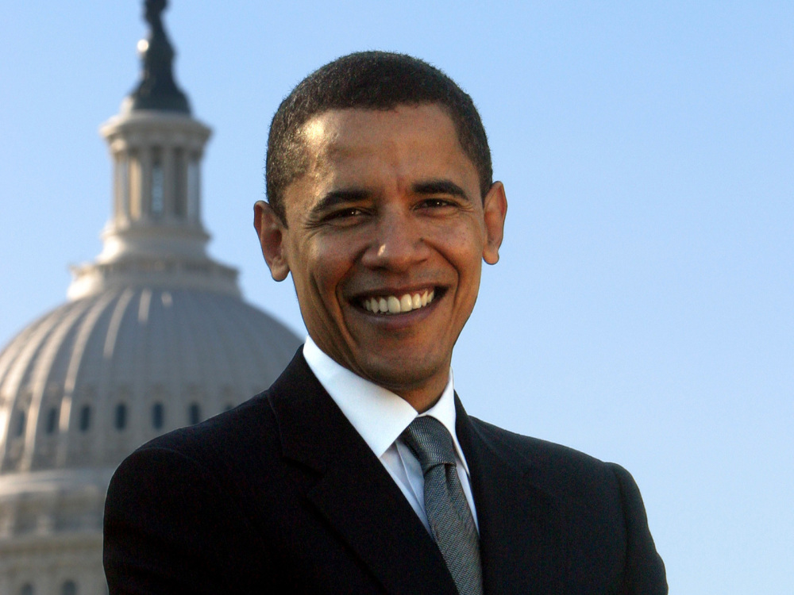
If you could go back in time,
what would you do different?

Slide 9
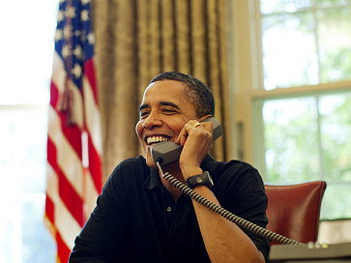
What's the side of you that the
public never sees?

Slide 10
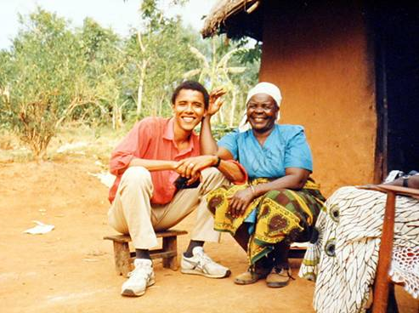
Why have you succeeded in a complicated field where so many others have failed?

Slide 11
What has been your formula for success?

Slide 12
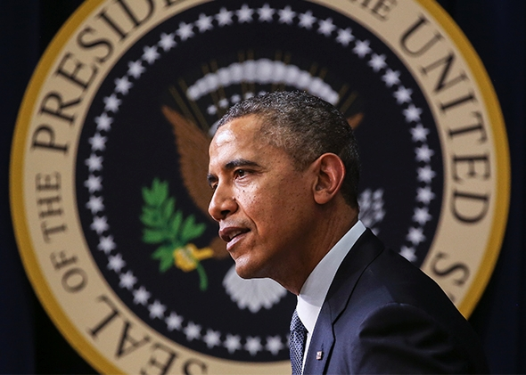
What has been your greatest achievement?

Slide 13
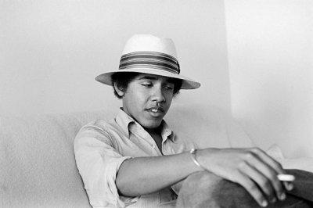
What advice would you give to today's youth?

Slide 14
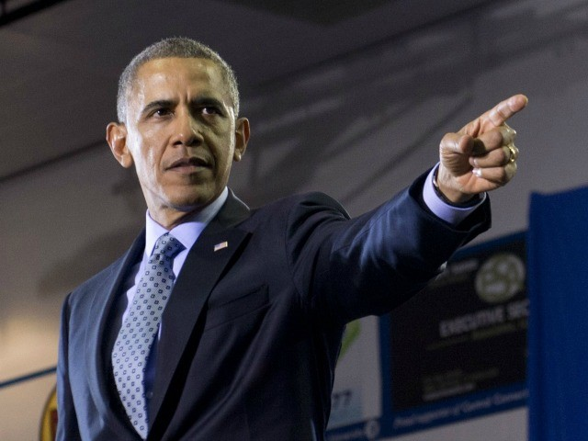
In yours own words,
define a successful person?

